Slide 1


Opening Prayer
“The synod is a process of spiritual discernment, of ecclesial discernment, that unfolds in adoration, in prayer and in dialogue with the word of God.”
Pope Francis
Homily from Opening of the Synodal Path
10 October 2021
usccb.org/synod

Slide 2
Synod for Parish Priests: My Personal Experience
200 parish priests from 99 countries
Tables of 12, grouped by English, Spanish, Italian and French
4 days of Communal Discernment and Writing Table Reports
Take Aways about Conversations in the Spirit:
    Usefulness of Prayer BEFORE the group is gathered
    Experience of Profound listening both in prayer and to each other.
    Recording Convergences, Divergences, Further Study.
    Takes discipline, practice, humility, courage and faith.

Slide 3
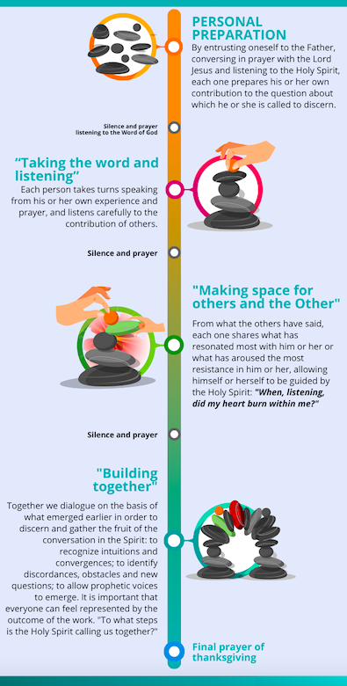
Conversation in the Spirit
usccb.org/synod

Slide 4
Let’s Try it Out
Practice (30 minutes)
  Set up the Ground Rules for the Today’s Practice
  Preview Questions for Discernment
  Lectio Divina (5 minutes of personal prayer)
  Practice Conversation in the Spirit at your tables

Slide 5
Discussion & Questions
What felt different in this way of conversing and discerning?
Did you struggle to listen deeply?
Did you struggle to speak honestly and courageously?
Did you sense a guidance by the Holy Spirit?
What might need more clarification in using this method?

Slide 6
Questions to choose from:
  #1: Jesus taught many beautiful things. He also said that being his disciple is difficult and demanding. What teaching of Jesus is the most challenging for most Americans today?
  #2: Pope Leo XIV is calling for another Worldwide Synod. What topic or question should be its focus?
  #3: The archdiocese has undertaken an amalgamation of parishes that will consider merging your parish with another nearby. One parish will close. Which one? What values should be the highest priorities. Take on roles as if you were members of the same parish.
  #4: Your parish will hire a new Full-Time position. What position / area needs that hire?
  #5: You’re on the Parish Pastoral Council and your pastor is considering changing the Mass times to accommodate Evangelization and Faith Formation Programming between Masses. One of the Mass times will be eliminated. Which one and why?
  #6: You or your spouse has a job offer in another city in Texas. The salary increase and new location are like a dream come true. However, you have children in high school who would have to relocate. Each of you take a role as members of the same family who have to make this decision.

